Slide 1
Advanced Object Oriented Programming SCHEDULE ME
By
G.Haritha Maithreyee(2110030014)
G.Mahitha Christina(2110030147)
A.Bhavya Sri(2110030067)
G.Vaishnavi(2110030009)
Under the guidance of
Mrs.Figlu Mohanty

Slide 2
Problem statement and domain
Often people forget their schedules due to busy life. In order to remind them we are here with Schedule Me Project.
This includes reminders for events ,meetings ,occasions and also date and time where user have to select to set the reminder.
It comes under Software Domain.

Slide 3
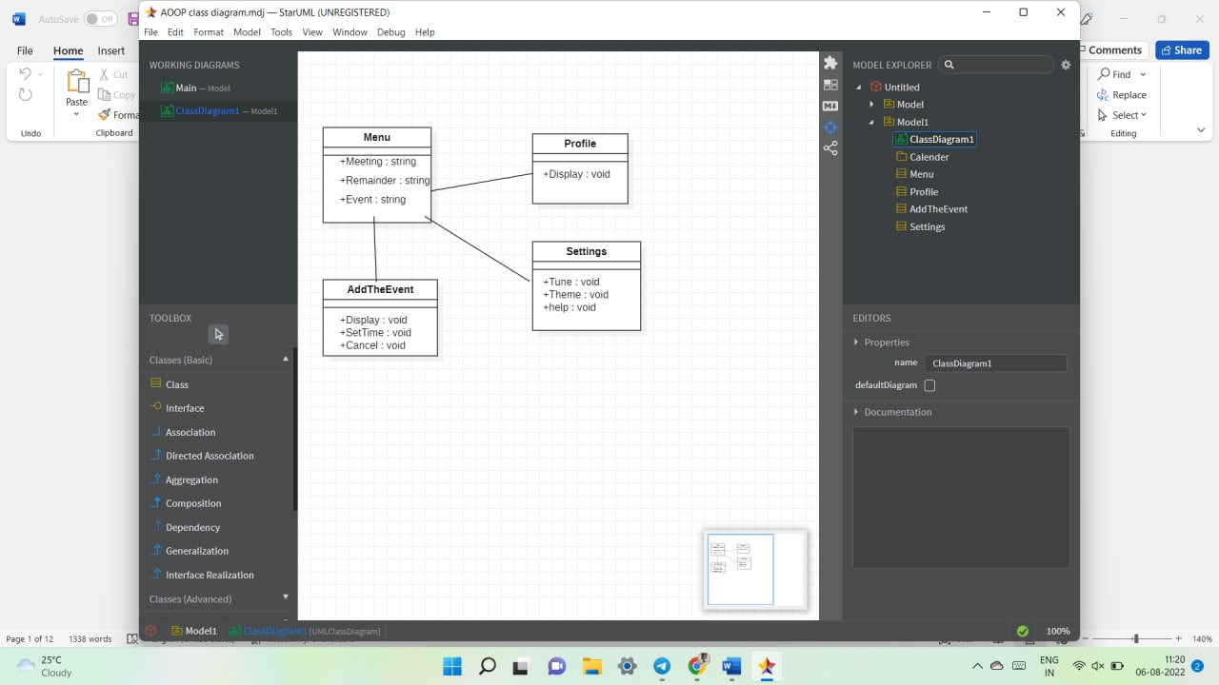
Class Daigram

Slide 4
How it works
Firstly ,the user needs to Login to the website with Email Id and password.
Then comes the Homepage from which they have to select reminder for where they have options like events ,meetings ,occasions.
Then they need to select date and time inorder to set the reminder.
If at all they want to cancel they can also do that by selecting cancel option.
They can even set ringtone for the same and set the volume.

Slide 5
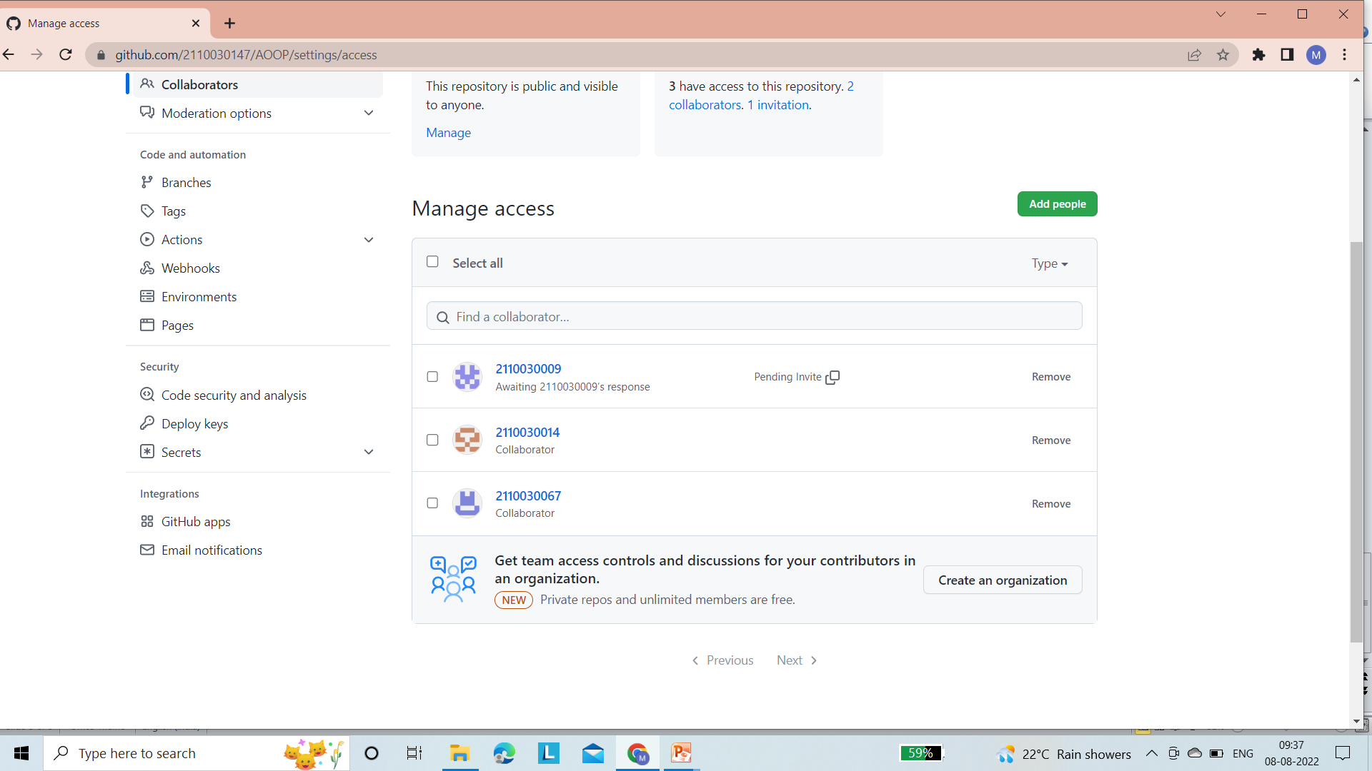
GitHub Setup

Slide 6
Division of work among the group members
2110030014 G.Haritha Maithreyee: Class Diagram
2110030147 G.Mahitha Christina: Class Diagram
2110030009 G.Vaishnavi: PPT
2110030067 A.Bhavya Sri: PPT

